Slide 1

Automatic Recognition
of Student Engagement
Using deep learning and facial expression
Omid Mohamad Nezami, Mark Dras, Len Hamey, Deborah Richards, Stephen Wan, and C´ecile Paris
Published in ECML PKDD 2019
Paper Link : https://ecmlpkdd2019.org/downloads/paper/241.pdf
Presenter:
Srijit Sen
(CS21MDS14009)
Teaching Assistant :
Khin Cho Win
Research Scholar
Instructor:
Dr. C Krishna Mohan
Professor

Slide 2
Motivation

Slide 3


Current problems
Even with the progress made in deep learning and faster processing speed, most engagements are still measured through manual processes like surveys, form fill ups and one-on-one interactions
Resulting in wastage of time during manual efforts
Data inconsistencies while taking feedback due to human error
Incomplete data, as not all are willing to provide information or even the correct information

Slide 4
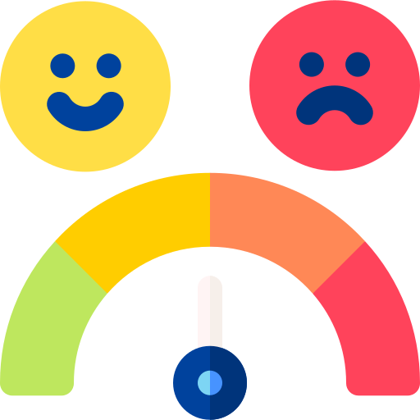

Why Automate Engagement?
Addresses the challenges of measuring and characterizing engagement during learning via technology
Provides a rich engagement facial representation model to aid in the development of educational tools and technologies that can better support students' learning experiences
Develops a deep learning-based model to automatically measure engagement using facial expressions extracted from images, which can be used to distinguish engaged and disengaged samples
Images provide accurate information on the state of their mind during the engagement period
With a good model, level of satisfaction can be measured more accurately
Real time actions can be taken based on the emotion at the time to keep the students engaged

Slide 5


Further Applications
Webinars conducted for training purposes in industrial setting
Physical Engagement settings like Seminars
Customer Satisfaction Measurement at physical stores by capturing
Driver engagement while driving vehicles to alert driver when getting disengaged and distracted

Slide 6
Problem Statement

Slide 7

What does this paper try to do?
Quantify and characterize engagement during learning via technology by automatically measuring it using facial expressions extracted from images
Challenge is to design a rich engagement representation model to distinguish engaged and disengaged samples, which requires a large amount of data that is difficult and expensive to collect and annotate due to the complexities and ambiguities of the engagement concept.
Use of a rich face representation model to capture basic facial expressions and initialize an engagement recognition model, the collection of a new dataset called the Engagement Recognition (ER) dataset to facilitate research on engagement recognition from images, and the use of deep learning techniques to model engagement, which outperforms a comprehensive range of baseline approaches on the ER dataset

Slide 8
Challenges

Slide 9
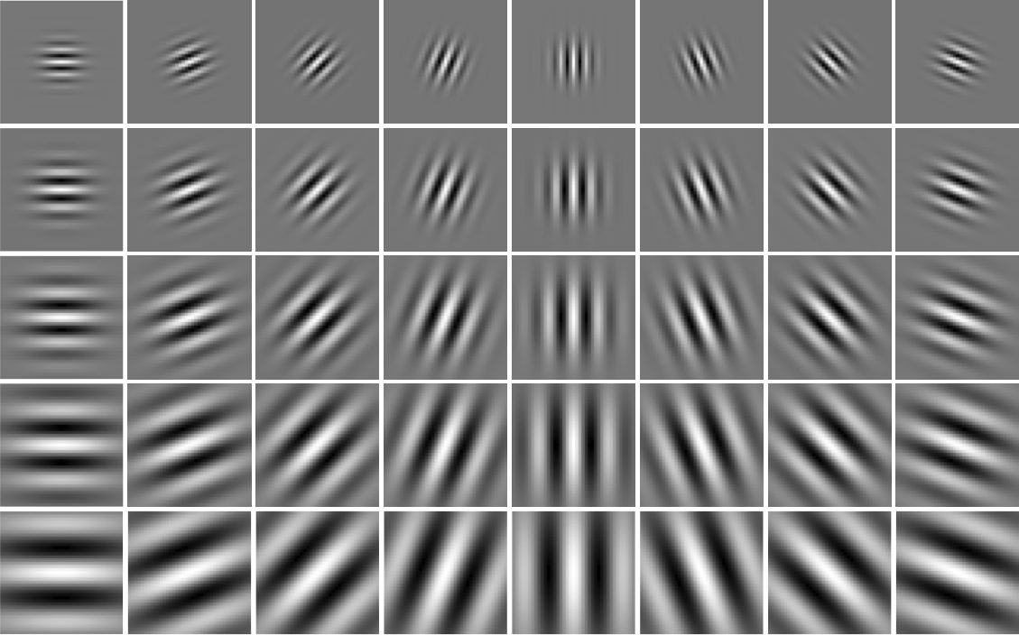
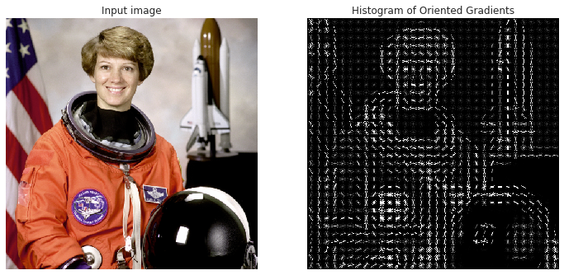
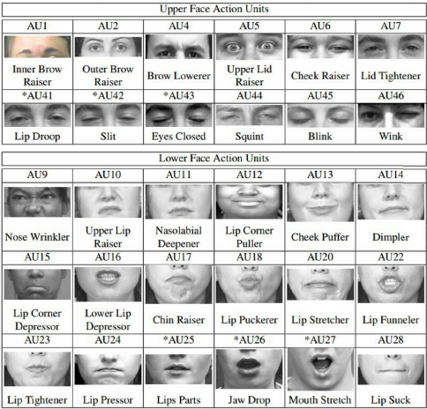
Why the solution has been difficult to build?
Lack of specific and high-level features for engagement recognition, which makes it difficult to distinguish engaged and disengaged samples using facial expressions. This requires a rich engagement representation model, which has not been explored in previous research
The need for a large amount of annotated data for training an engagement recognition model. Collecting and annotating engagement data is a complex and time-consuming process, and the concept of engagement is ambiguous, which further complicates the task
Notes:
general purposes, such as Gabor features histogram of oriented gradients and facial action units, there is no work in the literature investigating the design of specific and high-level features for engagement

Slide 10
Existing Work & Limitations

Slide 11
Other Related Work
Deep learning models have shown success in automatically recognizing facial expressions, with convolutional neural networks (CNNs) being a popular choice. Studies have used frameworks of six universal emotions: sadness, happiness, fear, anger, surprise, and disgust, along with a neutral category.
Other studies have combined visual and audio features, applied face detection methods, and trained CNN models across different FER datasets to enhance generalizability
Engagement has been detected in three different time scales: entire learning sessions, 10-second video clips and images. Grafsgarrd classified using linear regression while linear SVMs with Gabor features were used by Whitehall, heart rate features by [Monkaresi et al.], and Bayesian classifiers by [Bosch et al]. However, accurately assigning a single engagement label to each clip has been difficult and inaccurate
HOG+SVM model is similar to that of [Kamath et al] for recognizing engagement from images and is used as a baseline model in this work and applies gradient directions or edge orientations to express objects in local regions of images
Notes:
whitehill et al. [35] showed that engagement patterns are mostly recorded in images. Bosch et al. [4] also confirmed that video clips could not provide extra information by reporting similar performances using different lengths of video clips in detecting engagement

Slide 12
Limitations
Recognition of subtle differences:
Facial expressions can be very subtle, hence can pose a challenge to detect and differentiate between similar expressions, such as a smile and a smirk where the difference is very subtle
Limitations on available data:
Training a deep learning model for facial expression recognition requires a vast amount of data, which may not be easily accessible, particularly for rare expressions or populations.
Real-time recognition cases :
In some applications, such as human-robot interaction or driver monitoring, facial expressions need to be recognized in real-time due to the nature of the situation, which definitely is challenging due to the computational complexity of deep learning models

Slide 13
Limitations (contd.)
Subjectivity of engagement:
Engagement is a complex construct that can be challenging to define and measure objectively. Different individuals may have different engagement levels, and engagement can vary over time and across contexts
Availability of labeled data:
The availability of labeled data for engagement recognition is limited, particularly for fine-grained engagement levels or for specific populations. This can limit the development and evaluation of deep learning models for engagement recognition.
Integration of multiple modalities:
Engagement is not just conveyed through facial expressions but also through other nonverbal cues, physiological signals, and self-reported data. Integrating these modalities can improve the accuracy of engagement recognition but can also add complexity to the model.

Slide 14
Methodology in Detail
Setup
Facial Representation model and Architecture
Baseline Models and ER Model Architecture

Slide 15
Setup
Image data collected from students and annotated with behavior and engagement labels
FER 2013 Data
Input data
Input data
CNN Model
Generalized Facial Representation Model
The Class probabilities are used to initialize the softmax layer of ER model
ER Model
VGGNet Model
Engaged vs disengaged prediction
Input data
HOG+ SVM model
Performance evaluation by comparison with other baseline models
Notes:
new dataset annotated by Psychology students, who can potentially better recognize the psychological phenomena of engagement, because of the complexity of analyzing student engagement. To assist them with recognition, brief training was provided prior to commencing the task and delivered in a consistent manner via online examples and descriptions

Slide 16
How does the setup solve the challenges
Use of rich facial representation:
First time a rich face representation model has been used to capture basic facial expressions and initialize
an engagement recognition model. This makes the process of engagement recognition closer to real time
Creation of ER dataset:
Collected a new dataset we call the Engagement Recognition (ER) dataset to facilitate research on engagement recognition from images. To handle the complexity and ambiguity of engagement concept, our data is annotated in two steps, separating the behavioral and emotional dimensions of engagement. The final engagement label in the ER dataset is the combination of the two dimensions

Slide 17
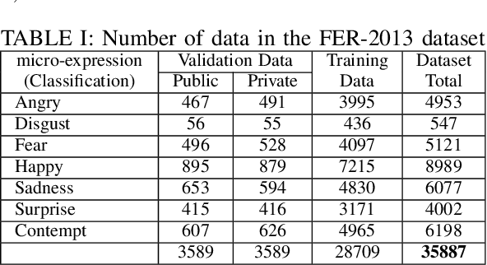
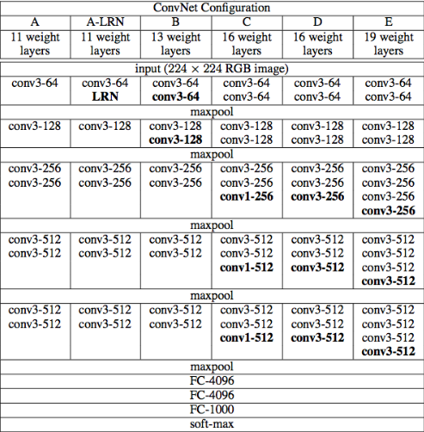
Facial Representation Model Architecture
Trained a VGG-B model using this dataset to recognize facial expressions, training set into two parts after removing 11 completely black samples, 3,589 for validating and 25,109 for training our facial expression recognition model
Used the Facial Expression Recognition 2013 (FER-2013) dataset, which contains grayscale images labeled with seven different emotions
Notes:
Adapted from VGG-B framework [32]. Each rectangle is a Conv. block including two Conv. layers. eight Conv. and three fully connected layers. We also have a max pooling layer after each Conv. block with stride 2. The model’s output layer has a softmax function generating the categorical distribution probabilities over seven facial expression classes

Slide 18
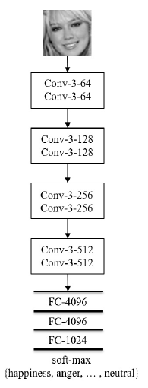
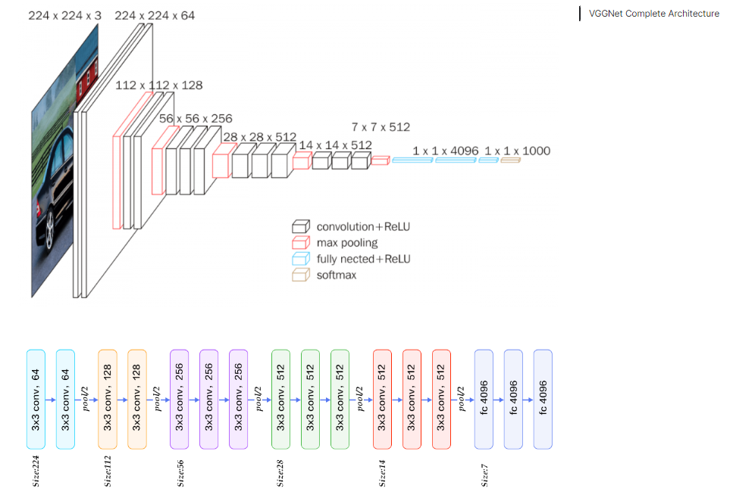
Facial Representation Model Architecture
The model’s output layer has a softmax function generating the categorical distribution probabilities over seven facial expression classes in FER-2013
Notes:
Adapted from VGG-B framework [32]. Each rectangle is a Conv. block including two Conv. layers. eight Conv. and three fully connected layers. We also have a max pooling layer after each Conv. block with stride 2. The model’s output layer has a softmax function generating the categorical distribution probabilities over seven facial expression classes

Slide 19
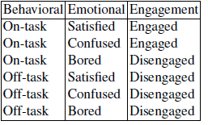

Engagement Recognition Model
ER dataset
consisting of 4,627 annotated images including 2,290 engaged and 2,337 disengaged
3,224 training dp
715 validation dp
688 test dp
Collected and annotated data with the psychologists, each sample is categorized
as engaged or disengaged by combining the dimensions’ For example, if a particular annotator labels an image as on-task and satisfied, the category for this image from this annotator is engaged
Notes:
normalized so that it has a zero mean and a norm equal to 100:0. Furthermore, for each pixel location, the pixel values are normalized to mean zero and standard deviation one using all ER training data

Slide 20
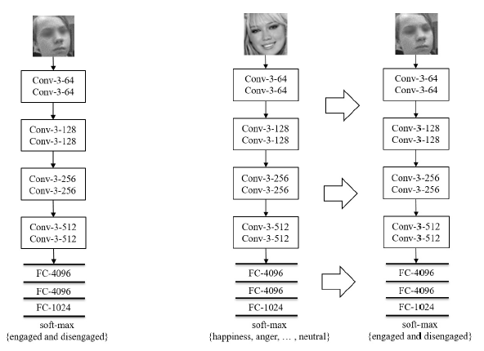
Engagement Recognition Model (contd.)
Two models are created which is like VGG-B architecture, but with two fewer Conv
One model’s weight is initialized randomly, calling this as VGGNET Model, show on the left and another model called Engagement Model, shown on the right and our prime focus which has same architecture except softmax layer initialized using the weights from the rich facial representation model
The model contains 8 convolutional (Conv.) layers Followed by two max pooling (Max.) layers with stride 2, and three fully connected (FC) layers, a rectified linear unit (ReLU) activation function and lastly, a softmax layer, followed by a cross-entropy loss, to classify between engaged and disengaged.
Notes:
To overcome model over-fitting, we apply a dropout layer after every Conv. and hidden FC layer. Local response normalization is used after the first Conv. layer. As the optimizer algorithm, stochastic gradient descent with minibatching and a momentum of 0.9 is used
In the training phase, for data augmentation, input images are randomly flipped along their width and cropped to 48-by-48 pixels (after applying zero-padding because the samples were already in this size). Furthermore, they are randomly rotated by a specific max angle.We set learning rate for the VGGNET MODEL to 0:001 and for other models to 0:002. The batch size is set to 32 for the ENGAGEMENT MODEL and 28 for other models. The best model on the validation set is used to estimate the performance on the test partition of the ER dataset for all models in this work.

Slide 21
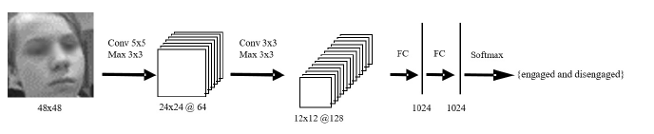
CNN Baseline Model
The model contains two convolutional (Conv.) layers and is termed as CNN Model
Followed by two max pooling (Max.) layers with stride 2, and two fully connected (FC) layers.
A rectified linear unit (ReLU) activation function is applied after all Conv. and FC layers.
Lastly, a softmax layer, followed by a cross-entropy loss, to classify between engaged and disengaged.
To overcome model over-fitting, we apply a dropout layer after every Conv. and hidden FC layer. Local response normalization is used after the first Conv. layer. As the optimizer algorithm, stochastic gradient descent with minibatching and a momentum of 0.9 is used
Notes:
normalized so that it has a zero mean and a norm equal to 100:0. Furthermore, for each pixel location, the pixel values are normalized to mean zero and standard deviation one using all ER training data

Slide 22
Evaluation & Results
Metrics
Findings

Slide 23


Metrics used for evaluation
Accuracy
classification accuracy specifies the number of positive (engaged) and negative (disengaged) samples which are correctly classified and are divided by all testing samples
TP, TN, FP, and FN are true positive, true negative, false positive, and false negative, respectively
F1 Score
P is precision defined as (TP/TP+FP) and r is recall defined as (TP/TP+FN)
AUC
AUC is a popular metric in engagement recognition task. It is an unbiased assessment of the area under the ROC curve. An AUC score of 0.5 corresponds to chance performance by the classifier, and AUC 1.0 represents the best possible result

Slide 24
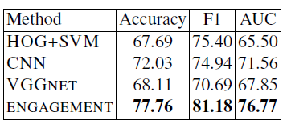
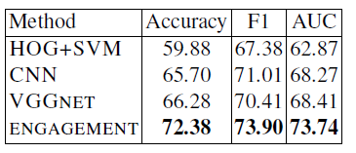
Findings from evaluations
Validation Result
On the validation and test sets, the ENGAGEMENT model substantially outperforms all baseline models using all evaluation metrics, showing the effectiveness of using a trained model on basic facial expression data to initialize an engagement recognition model
All deep models including CNN, VGGNET, and ENGAGEMENT MODELS perform better than the HOG+SVM method showing the benefit of applying deep learning to recognize engagement
Test Result
Notes:
On the test set, the ENGAGEMENT MODEL achieves 72:38% classification accuracy, which outperforms VGGNET by 5%, and the CNN MODEL by more than 6%; it is also 12:5% better than the HOG+SVM method. The ENGAGEMENT MODEL achieved 73:90% F1 measure which is around 3% improvement compared to the deep baseline models and 6% better performance than the HOG+SVM MODEL. Using the AUC metric, as the most popular metric in engagement recognition tasks, the ENGAGEMENT MODEL achieves 73:74% which improves the CNN and VGGNET MODELS by more than 5% and is around 10% better than the HOG+SVM method. There are similar improvements on the validation set

Slide 25
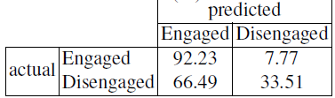
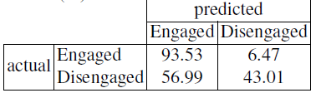
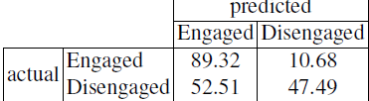
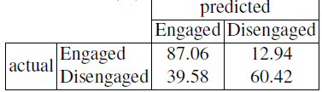
Findings from evaluations
HOG+SVM Model
The VGGNET MODEL, which has a more complex architecture compared to the CNN MODEL, can also detect disengaged samples with a higher probability
ENGAGEMENT MODEL on basic facial expression data including considerable variations of samples, this model is the most effective approach to recognize disengaged samples achieving 60.42% precision which is around 27% improvement in comparison with the HOG+SVM MODEL
CNN Model
VGGNET Model
ER Model

Slide 26
Conclusion

Slide 27
Conclusion
The paper contributes by creating a new dataset for engagement recognition from visual data, labelled by psychologists, to address the shortage of data for training engagement recognition models
The authors developed a deep learning model called ENGAGEMENT MODEL, which pre-trains on basic facial expression data and then trains to produce a rich deep learning-based representation for engagement
The model was evaluated against baseline models and showed a significant improvement in engagement recognition using standard evaluation metrics specifically disengaged samples by more than 27% against the HOG-SVM model
Future Implementations to be performed:
Test the model on FER+ dataset in place of its ER dataset
Play around with model network architecture to see its impact on time complexity and accuracy, also look at whether ResNet architecture can be implemented in this problem statement as another baseline model

Slide 28
References

Slide 29
References
Whitehill, J., Serpell, Z., Lin, Y.C., Foster, A. and Movellan, J.R., 2014. The faces of engagement: Automatic recognition of student engagementfrom facial expressions. IEEE Transactions on Affective Computing, 5(1), pp.86-98.
Alyuz, N., Okur, E., Oktay, E., Genc, U., Aslan, S., Mete, S.E., Arnrich, B., Esme, A.A.:Semi-supervised model personalization for improved detection of learner’s emotional en-gagement. In: ICMI. pp. 100–107. ACM (2016)
Aslan, S., Mete, S.E., Okur, E., Oktay, E., Alyuz, N., Genc, U.E., Stanhill, D., Esme, A.A.:Human expert labeling process (help): Towards a reliable higher-order user state labeling process and tool to assess student engagement. Educational Technology pp. 53–59 (2017)
Bosch, N.: Detecting student engagement: Human versus machine. In: UMAP. pp. 317–320.ACM (2016)
Bosch, N., D’Mello, S., Baker, R., Ocumpaugh, J., Shute, V., Ventura, M., Wang, L., Zhao,W.: Automatic detection of learning-centered affective states in the wild. In: IUI. pp. 379–388. ACM (2015)
Notes:
Read content

Slide 30
The End

